Slide 1
Website Project Plan
Site Purpose: My website is a math & physics toolkit that features multiple tools that help math and physics students to make calculations
Target Audience: students, professionals and enthusiasts

Slide 2
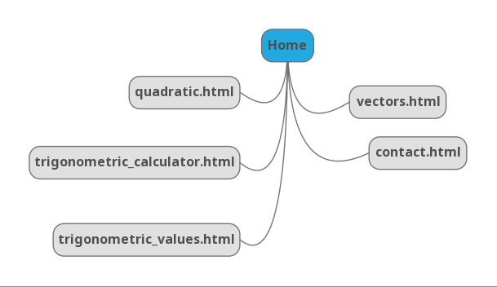
Site Map

Slide 3
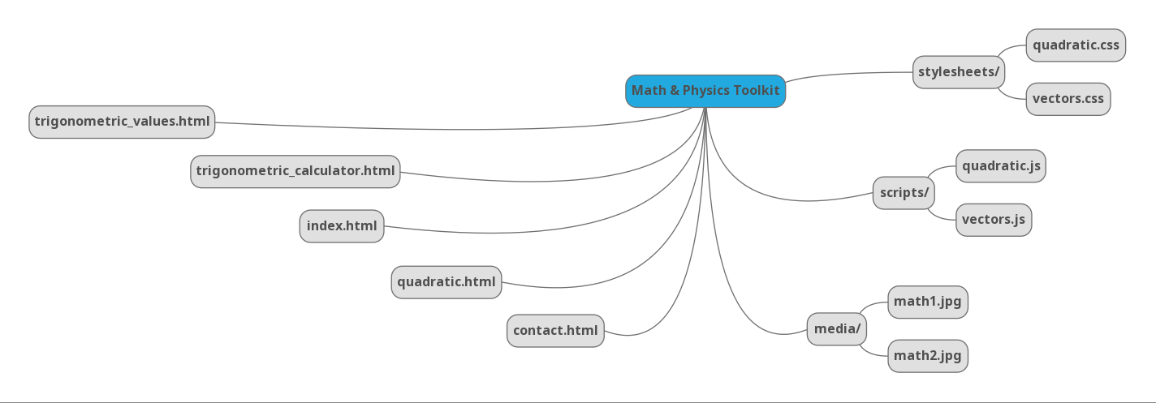
Directory Structure

Slide 4
Accessibility
I will use Accessibility Checker
To evaluate my site for accessibility and fix any errors (to the best of my ability) the accessibility audit produces.
If I do not know what an error means or how to fix it, I will do some research to figure out what the error means, at least.

Slide 5
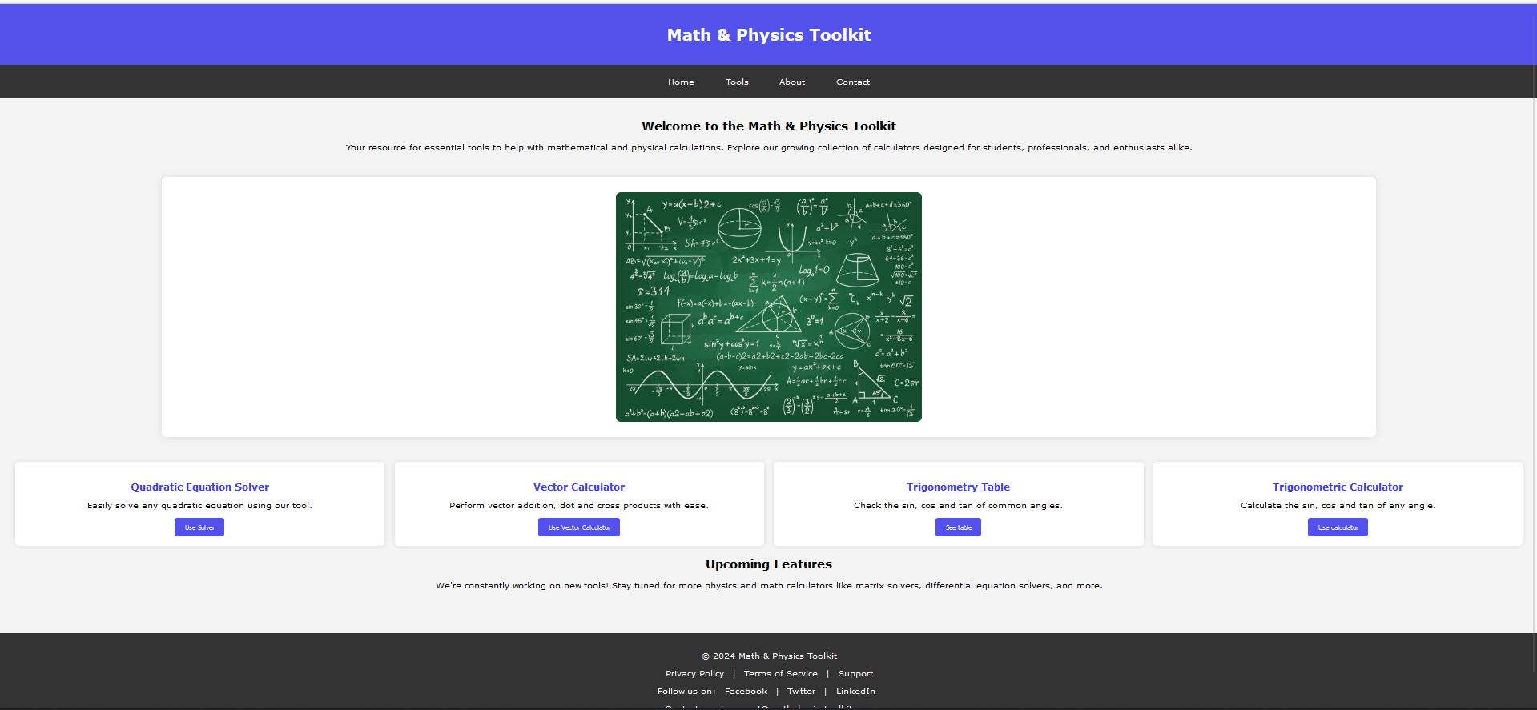

Slide 6
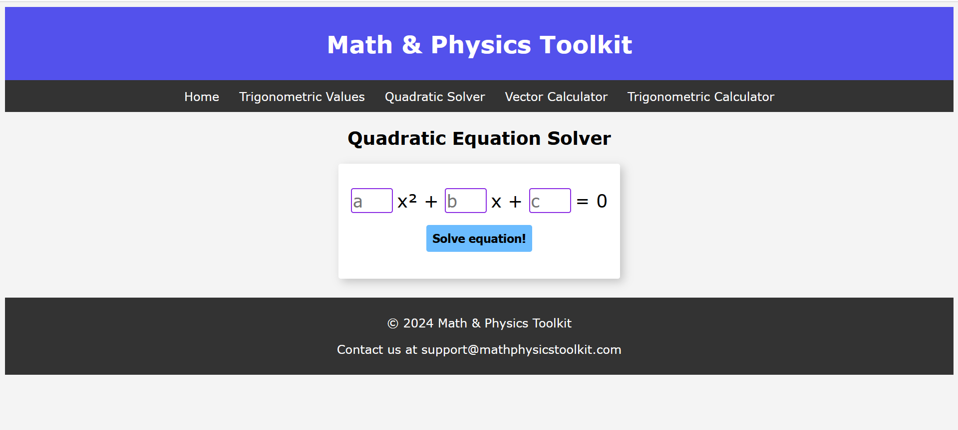

Slide 7
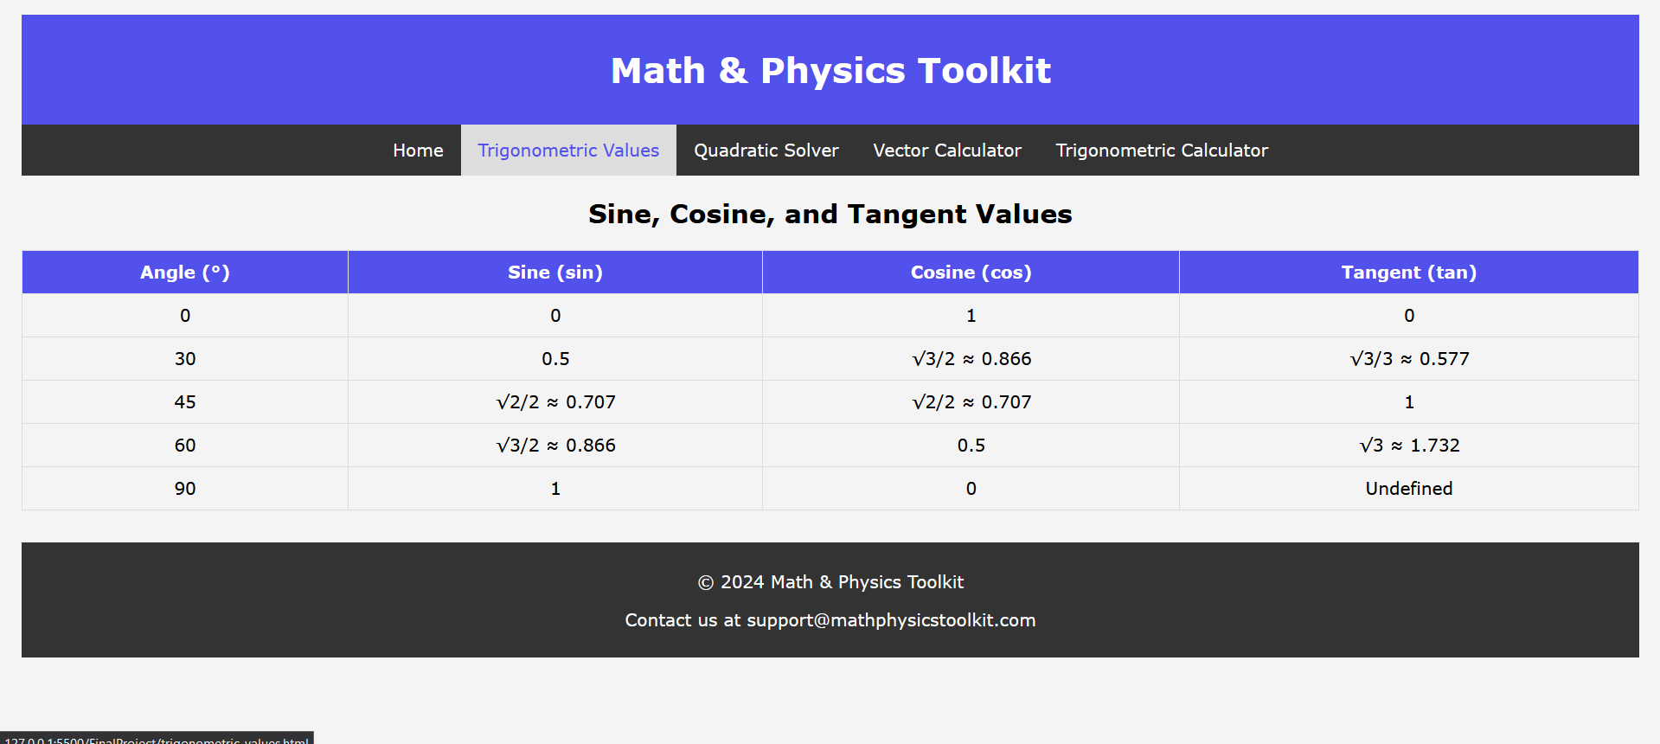

Slide 8
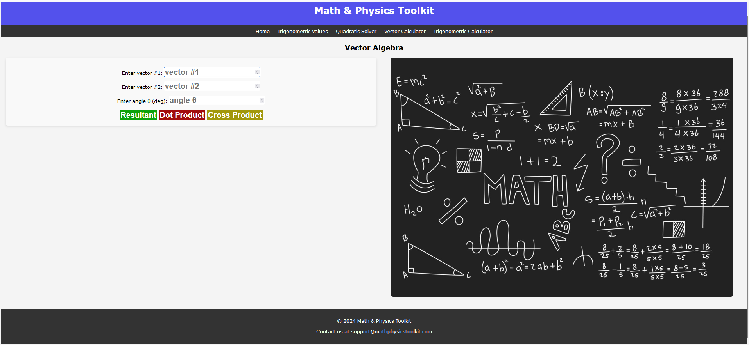

Slide 9
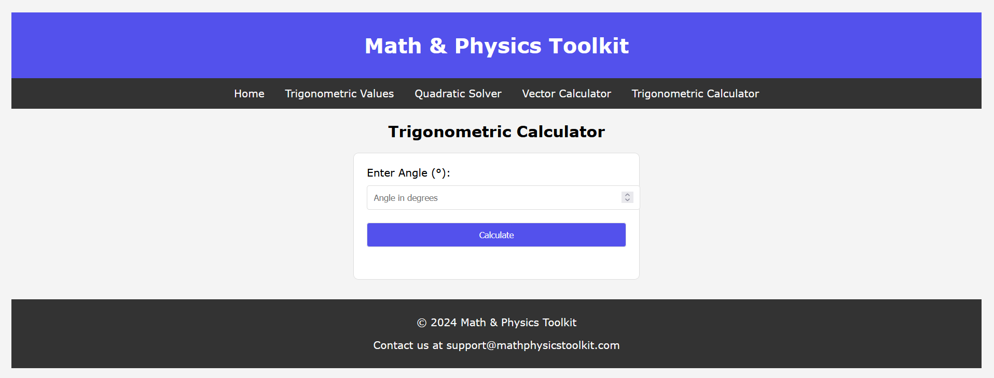

Slide 10
